Slide 1
CS3391 Object Oriented Programming
Dr.D.Sivaganesan, Professor, PSGiTech / CSE
CS8392 Object Oriented Programming Dr.D.Sivaganesan and N.Arvindhraj PSGiTech / CSE
1

Slide 2
ABSTRACT CLASS
A class that is declared with abstract keyword, is known as abstract class in java.
It can have abstract and non-abstract methods (method with body). Abstraction is a process of hiding the implementation details and showing only functionality to the user.
Abstraction lets you focus on what the object does instead of how it does it. It needs to be extended and its method implemented. It cannot be instantiated. A method that is declared as abstract and does not have implementation is
known as abstract method.
Syntax :
abstract class:
abstract class A{ }
abstract method:
abstract methodname { }
CS8392 Object Oriented Programming
Dr.D.Sivaganesan and N.Aravindhraj PSGiTech / CSE
2

Slide 3
abstract class Shape
{
abstract void draw();
}
class Rectangle extends Shape
{
void draw()
{
System.out.println("drawing rectangle");
} }
class Circle extends Shape
{
void draw()
{
System.out.println("drawing circle");
}}
class exabs
{
public static void main(String args[])
{ // Shape c=new Circle(); Circle c=new Circle(); Rectangle r=new Rectangle(); r.draw();
c.draw();
}}
CS8392 Object Oriented Programming
Dr.D.Sivaganesan and N.Arvindhraj PSGiTech / CSE
3

Slide 4

CS8392 Object Oriented Programming
Dr.D.Sivaganesan and N.Aravindhraj PSGiTech / CSE
4

Slide 5
An abstract class can have data member, abstract method, method body,
constructor
//example of abstract class that have method body
abstract class Bike{ int a=10;
Bike(){// constrctor
System.out.println(“constructor in abstract class -bike is created");}
abstract void run(); // abstract method
void changeGear(){
System.out.println("gear changed");} // method
}
class Honda extends Bike{
void run(){
System.out.println("running safely..“+a);}
}
class abscons{
public static void main(String args[]){
Bike obj = new Honda(); obj.run(); obj.changeGear(); }}
CS8392 Object Oriented Programming
Dr.D.Sivaganesan and N.Arvindhraj PSGiTech / CSE
5

Slide 6
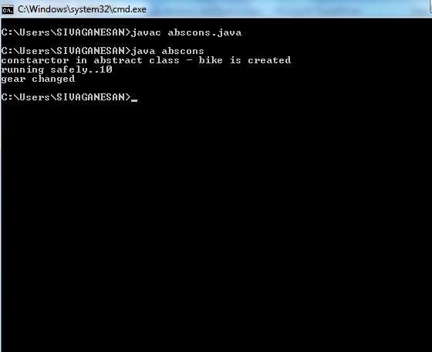
CS8392 Object Oriented Programming
Dr.D.Sivaganesan and N.Aravindhraj PSGiTech / CSE
6

Slide 7
FINAL KEYWORD
Final keyword can be used along with variables, methods and classes.
final variable
final method final class
Java final variable
A final variable is a variable whose value cannot be changed at anytime once assigned, it
remains as a constant forever. Syntax : final datatype var=value:
Example:
public class Finalvar
{
final int SPEED=60; void increaseSpeed(){ SPEED=70;
}
public static void main(String args[])
{
Finalvar t=new Finalvar();
t.increaseSpeed();
}}
CS8392 Object Oriented Programming
Dr.D.Sivaganesan and N.Arvaindhraj PSGiTech / CSE
7

Slide 8
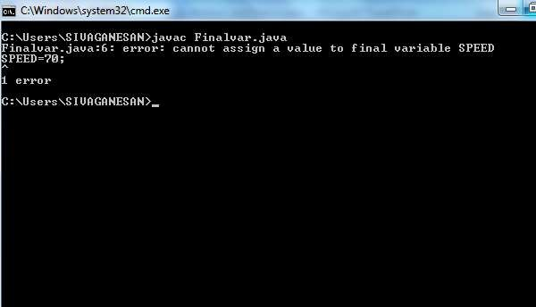
CS8392 Object Oriented Programming
Dr.D.Sivaganesan and N.Arvindhraj PSGiTech / CSE
8

Slide 9
final method
When you declare a method as final, then it is called as final method. A final method cannot
be overridden. Syntax : final return datatype methodname () { method def ;}
class Parent
{
int a=10;
final void display()
{
System.out.println("final method"+a);
}
}
class Finalclass extends Parent
{
void display()
{
System.out.println("main class method");
}
public static void main(String args[])
{
Finalclass c = new Finalclass(); c.display();
}
}
CS8392 Object Oriented Programming
Dr.D.Sivaganesan and N.Arvindhraj PSGiTech / CSE
9

Slide 10
final class
A final class cannot be extended(cannot be subclassed),
final class Parent
{
int a=10;
}
class Finalclass extends Parent
{
public static void main(String args[])
{
Finalclass c = new Finalclass();
}
}
CS8392 Object Oriented Programming Dr.D.Sivaganesan and N.Arvindhraj PSGiTech / CSE
10

Slide 11

CS8392 Object Oriented Programming
Dr.D.Sivaganesan and N.Arvindhraj PSGiTech / CSE
11

